Slide 1

Exploratory Data Analysis
G2M insight for Cab Investment firm
May 21st 2023

Slide 2
Agenda
Executive Summary
Problem Statement
Data Details
Exploratory Data Analysis Approach
Exploratory Data Analysis Summary
Hypothesis
Recommendations
References

Slide 3
Executive Summary
Company: XYZ
Interested in: Cab investment
Strategy: Go to Market (G2M)
Location: US

Slide 4
Problem Statement
XYZ is a private firm in US. Due to remarkable growth in the Cab Industry in last few years and multiple key players in the market, it is planning for an investment in Cab industry and as per their Go-to-Market (G2M) strategy they want to understand the market before taking final decision.

Slide 5
Data Details
There are 4 datasets.
Time period of data is from 31/01/2016 to 31/12/2018.
Below are the list of datasets which are provided for the analysis:
Cab_Data.csv – this file includes details of transaction for 2 cab companies (Pink Cab and Yellow Cab)
Customer_ID.csv – this is a mapping table that contains a unique identifier which links the customer’s demographic details
Transaction_ID.csv – this is a mapping table that contains transaction to customer mapping and payment mode
City.csv – this file contains list of US cities, their population and number of cab users
Note: US Holidays dataset has been downloaded to analyse the days off during the year. US Holiday Dates (2004-2021).csv - this file contains list of holidays, with their date, weekday, day, month and year [1].

Slide 6
Exploratory Data Analysis Approach
Understanding the Data
Data Cleaning
Master Data
Outlier Detection
Data Visualization

Slide 7
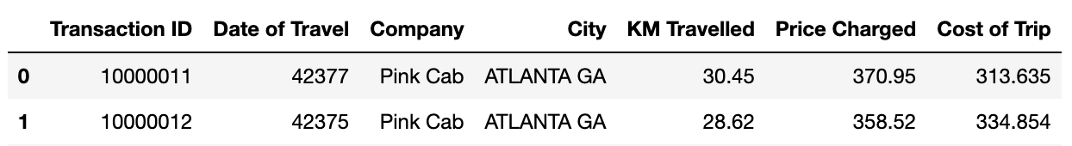
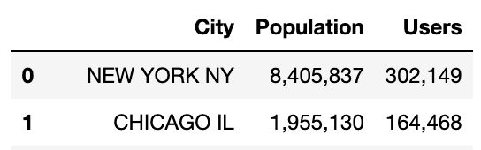
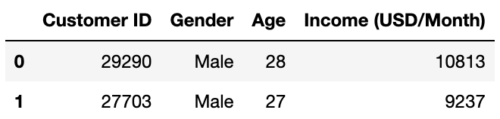
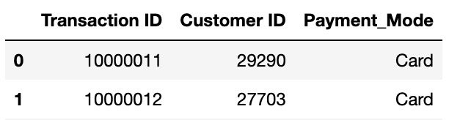
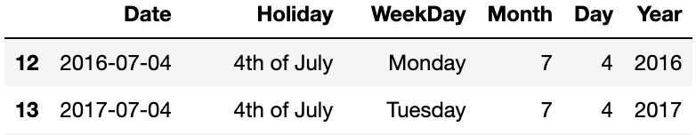
Understandi-ng Data
The Cab_Data dataset has 359392 records and 7 columns as shown below.
The City dataset has 20 records and 3 columns as shown below.
The Customer_ID dataset has 49171 records and 4 columns as shown below.
The Transaction_ID dataset has 440098 records and 3 columns as shown below.
Note: US Holiday data was downloaded to understand the days off during the year 2016 to 2018. The Holidays dataset has 57 records and 6 columns as shown below.

Slide 8
Data Cleaning
There are no missing values in any of the datasets.
Date of Travel variable was converted from int64 to datetime datatype in Cab_Data dataset.
Population and Users variables were converted to int64 datatype in City dataset.
Datatypes of the variables on Customer_ID and Transaction_ID datasets looks fine.
There were no duplicate data in any of the datasets.
Year and Month were extracted from Date of Travel variable in Cab_Data dataset

Slide 9
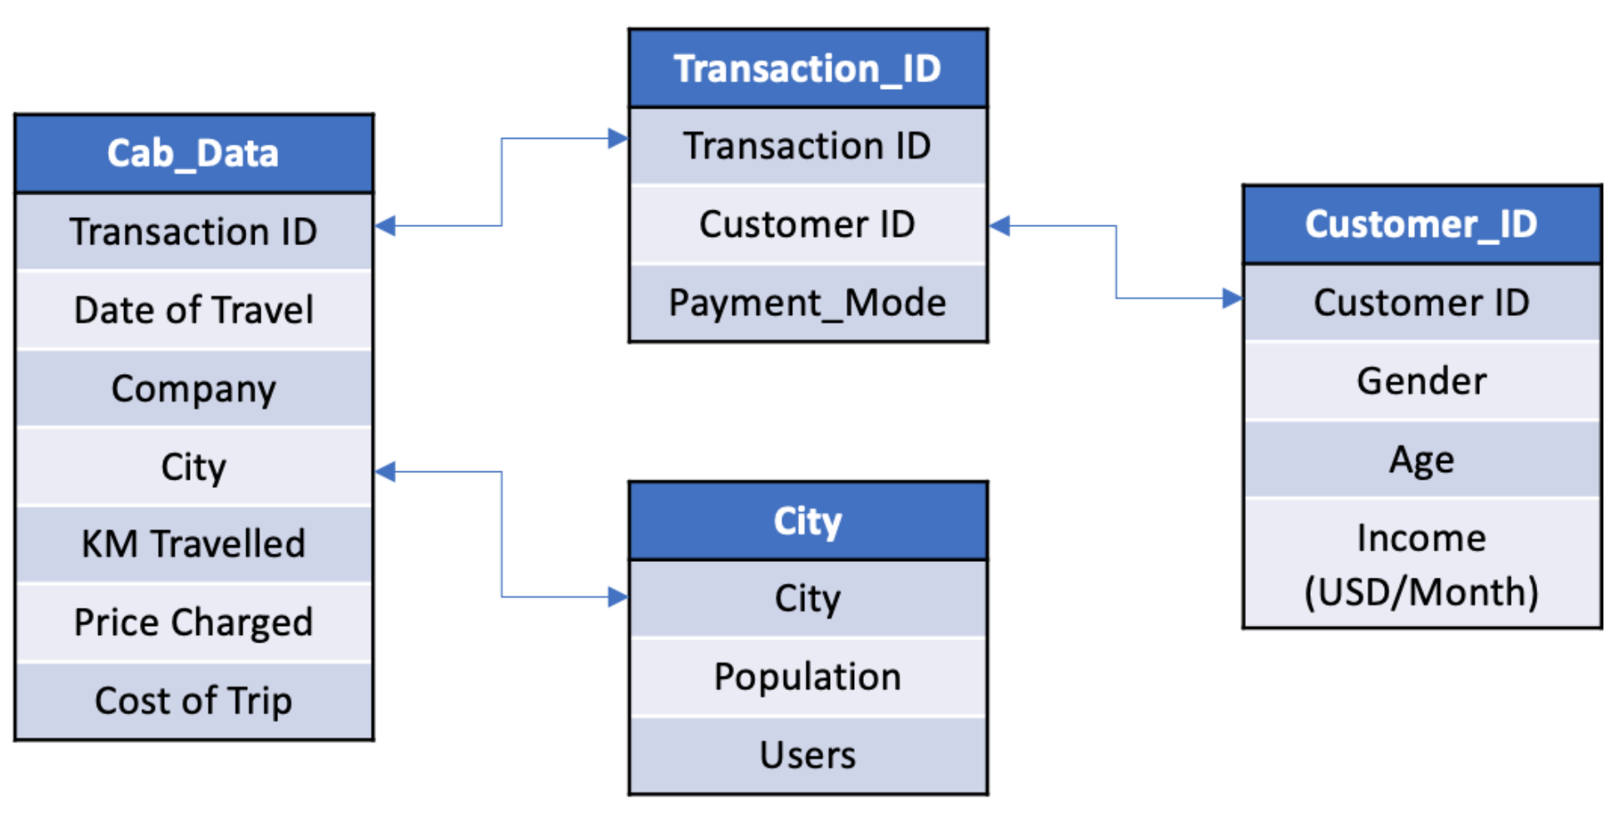
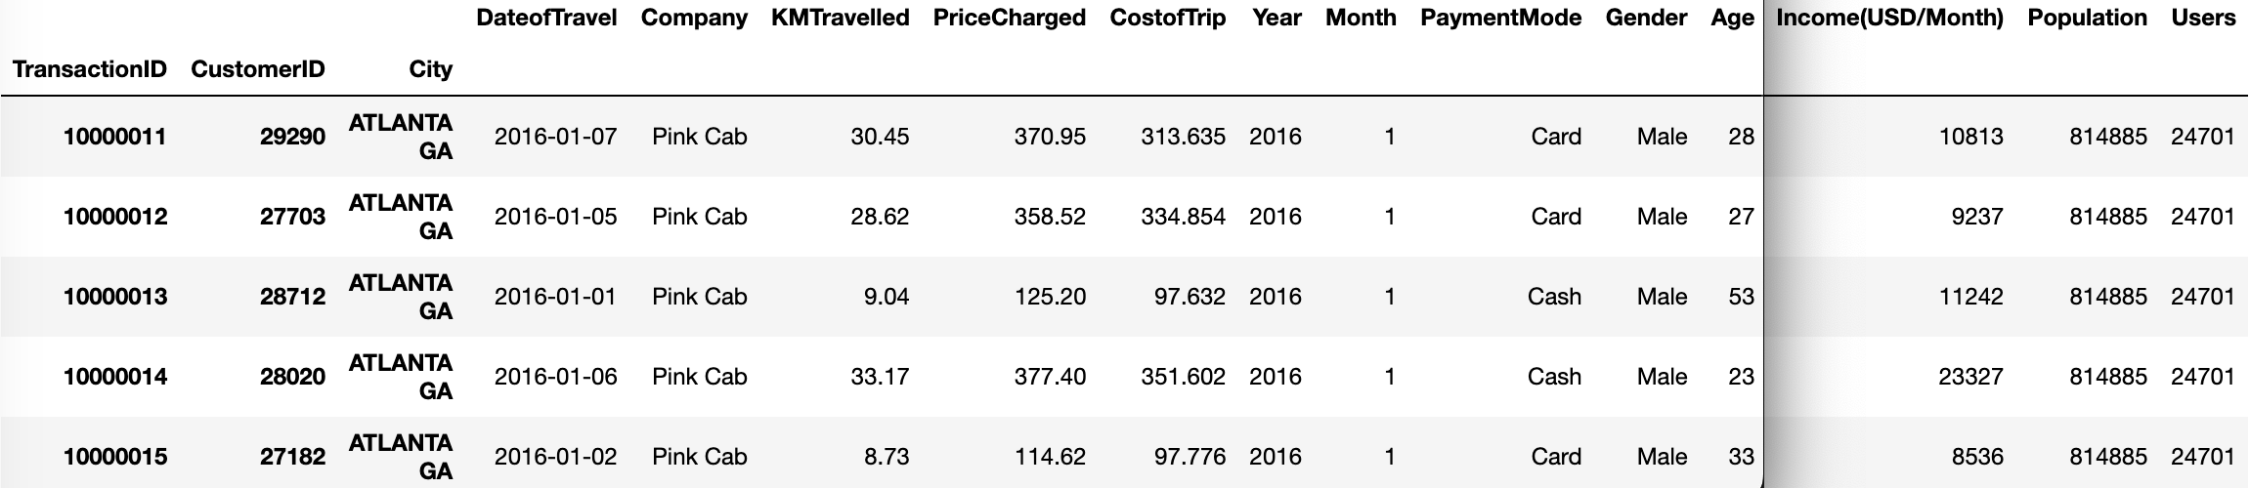
Master Data
1. Transaction ID variable is the common key on Cab_Data and Transaction_ID datasets. Hence, Cab_Data and Transaction_ID datasets can be combined by using Transaction ID variable.
2. Customer ID variable is the common key on Transaction_ID and Customer_ID datasets. Hence, Transaction_ID and Customer_ID datasets can be combined by using Customer ID variable.
3. City variable is the common key on Cab_Data and City datasets. Hence, Cab_Data and City datasets can be combined using City variable.
Master dataset is shown below.

Slide 10
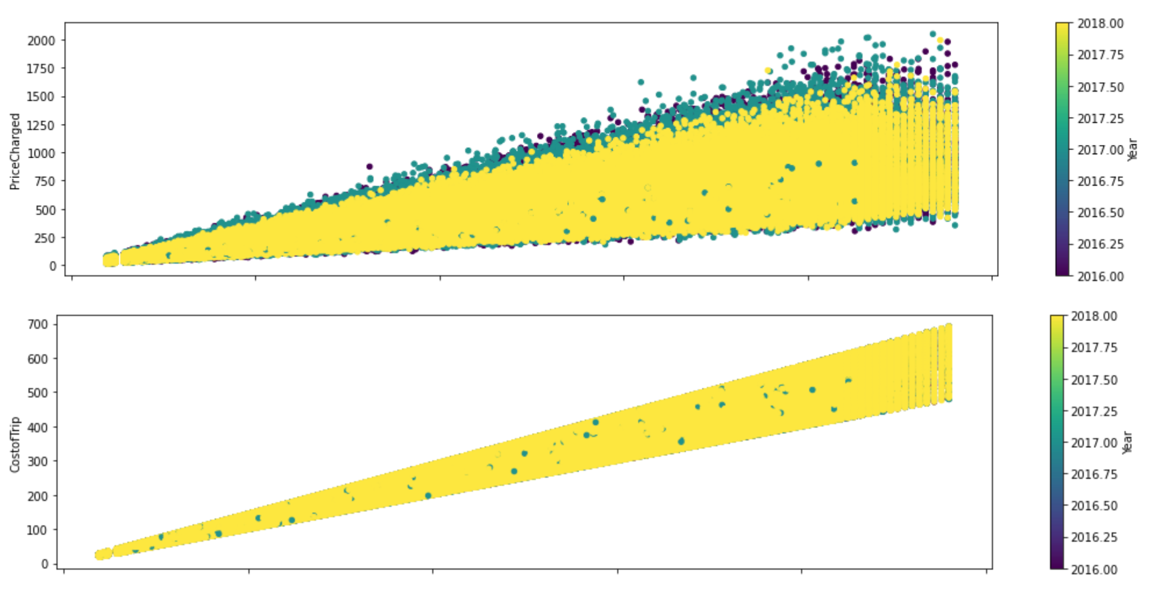
Outlier Detection
There seems to be some outliers in Price Charged variable. However, keeping these outliers as the distance travelled varies and it might be important to get the Profit Margin.

Slide 11
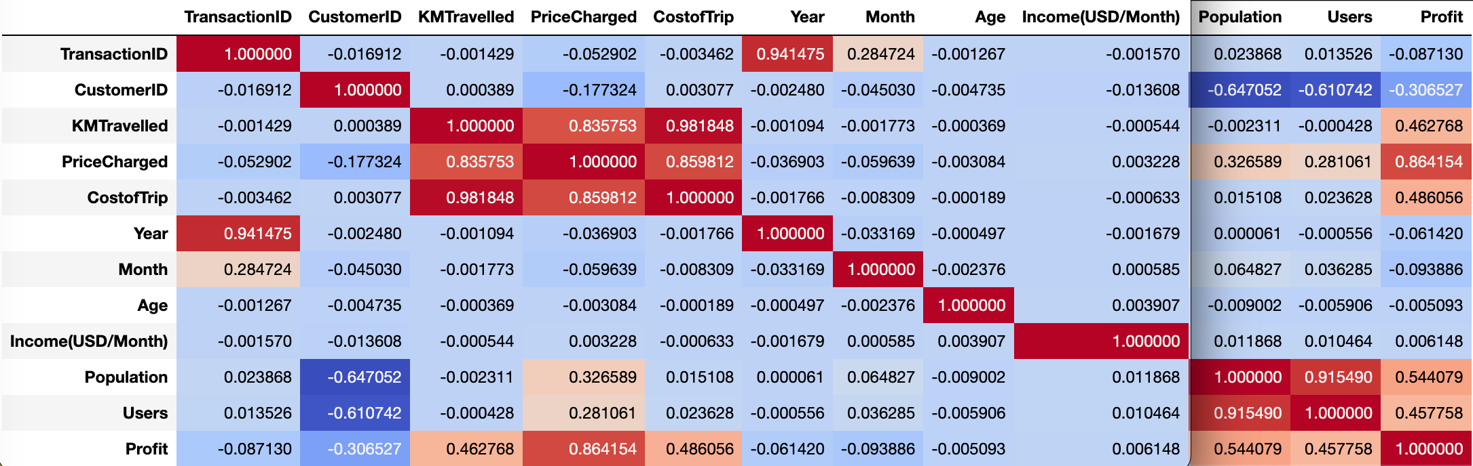
Data Visualization
Correlation between data variables
There seems to be a correlation between KMTravelled with Price Charged/Cost of Trip. Also, Price Charged and Cost of Trip are correlated.
There seems to be a correlation between Price Charged with Population and Users.

Slide 12
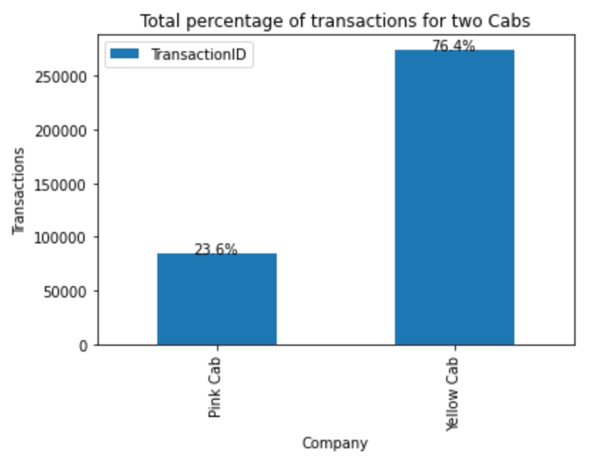
Data Visualization - cont
Analyzing the percentage of Pink and Yellow Cab
There seems to be a huge difference in the total number of transactions between Pink and Yellow cabs. Pink Cab is just 23.6% and Yellow has been 76.4%.

Slide 13
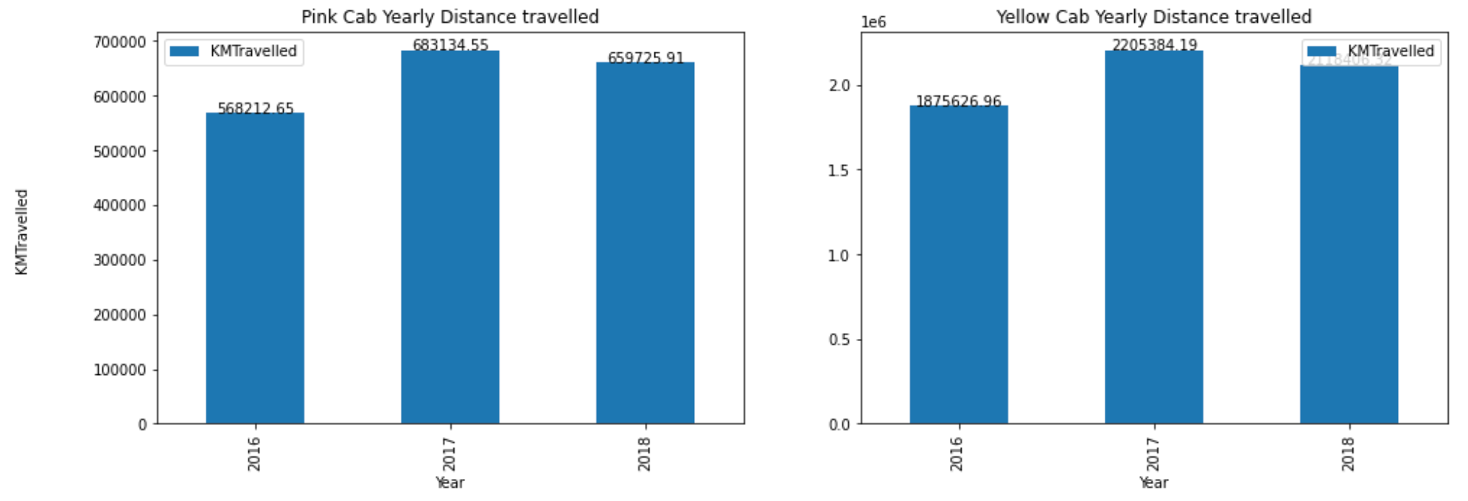
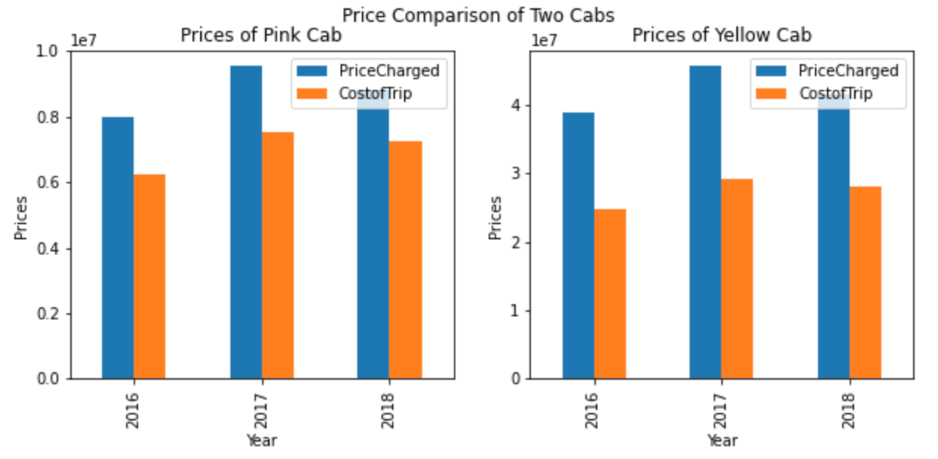
Data Visualization - cont
Yearly Analysis of Pink and Yellow cabs by KMTravelled and Prices
Distance travelled by Yellow cab per year is more than Pink cab, however the percent of travel in each year by each cab is not much different. Year 2017 has the highest percentage of travel compared to 2016 and 2018 for both the cabs.
Profit margin by Yellow cab is more than Pink cab, as the difference between Price charged and Cost of Trip depicted in the graph above is more for Yellow cab than Pink cab in each year

Slide 14
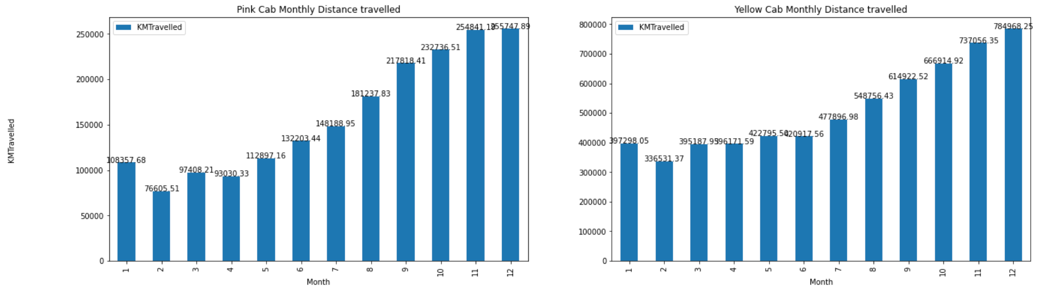
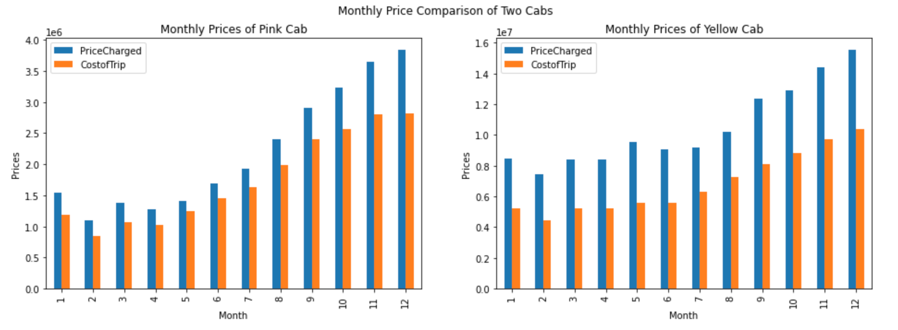
Data Visualization - cont
Monthly Analysis of Pink and Yellow cabs by KMTravelled and Prices
From above 4 graphs, its clear that the distance and profit margin of Yellow cab is more than Pink cab and is maximum in the month of December

Slide 15
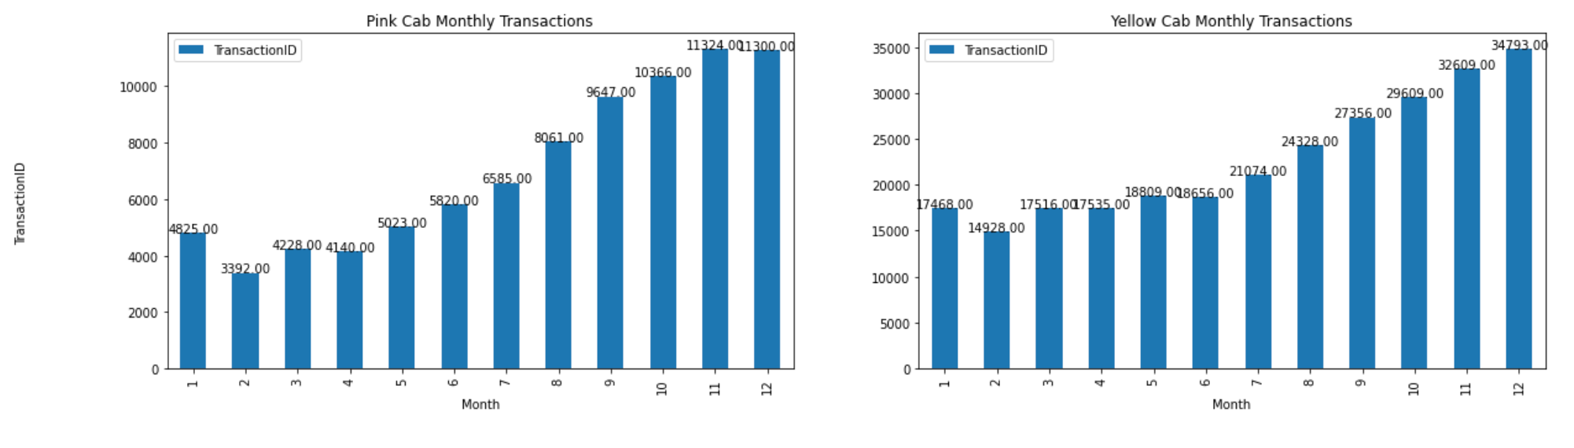
Data Visualization - cont
Monthly Analysis of Pink and Yellow cabs by TransactionID
It's clear that the number of transactions in Dec months is more for both cabs compared to other months.
The number of transaction by Yellow cab in the month of Dec is between 30000 and 35000 where as, by Pink cab its between 10000 and 12000.

Slide 16
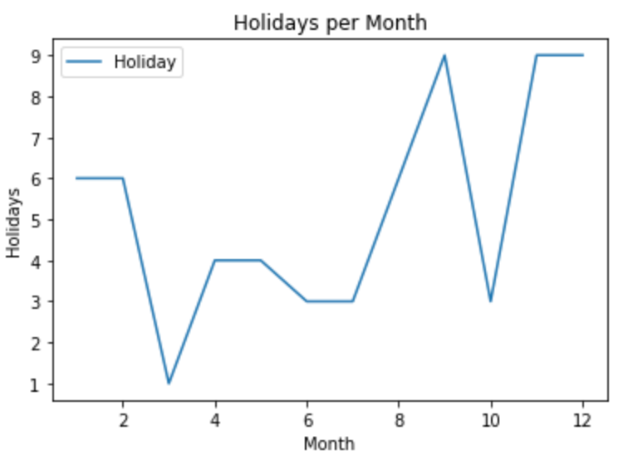
Data Visualization - cont
Analysis of Holidays dataset
Number of holidays in the month of Sep, Nov and Dec are higher than rest of the months. This depicts that due to holidays in the month of Dec, the travel transactions are higher, which also leads to be the most profitable months

Slide 17
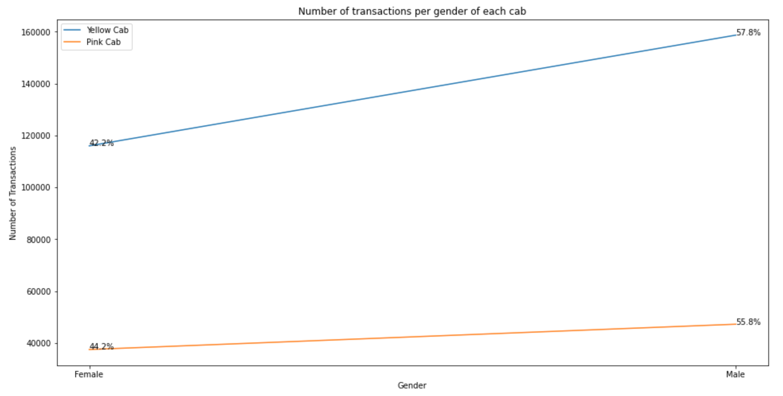
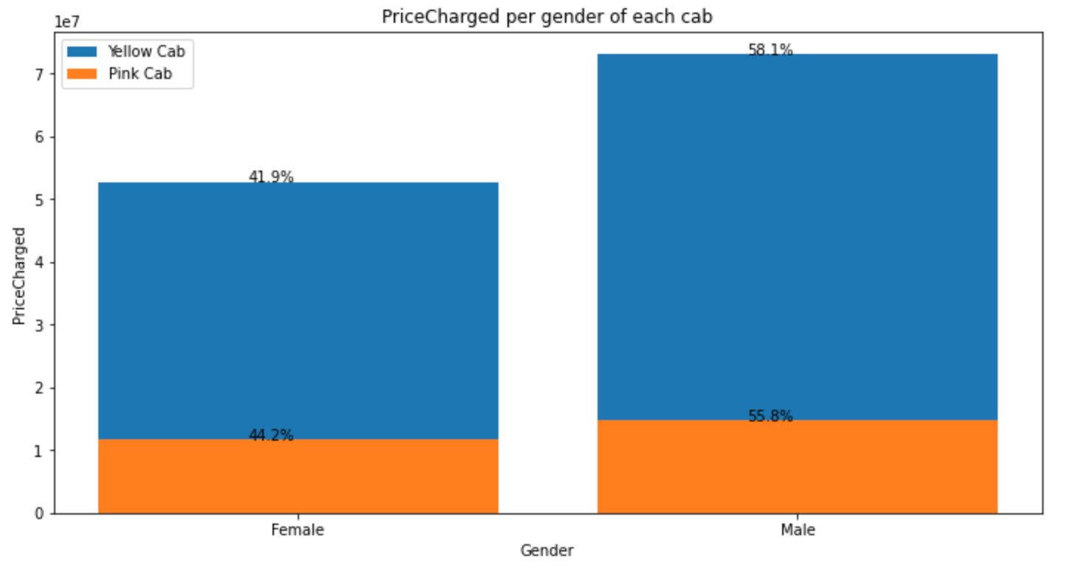
Data Visualization - cont
Analysis of Pink and Yellow cabs by Gender
In Yellow cab, the numbers of transactions by Male customers are nearly 15% more than Female customers. Whereas in Pink Cab, the number of Male are 10% more than the Female users.
Pink cab charged nearly same price for Male and Female users.
Yellow cab charged higher Price for Male users than Female users.

Slide 18
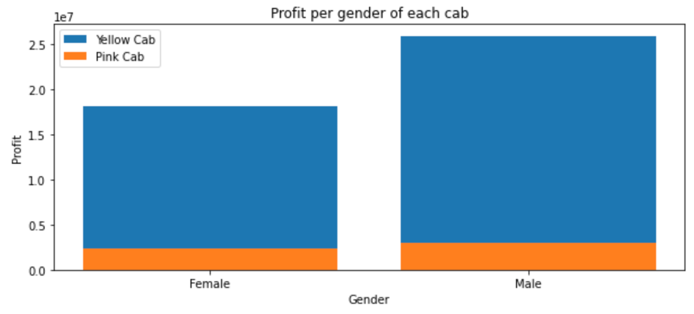
Data Visualization - cont
Profit of Pink cab is very less for both Male and Female users than Yellow cab.
Profit of Yellow cab is relatively high for Male users than Female users.

Slide 19
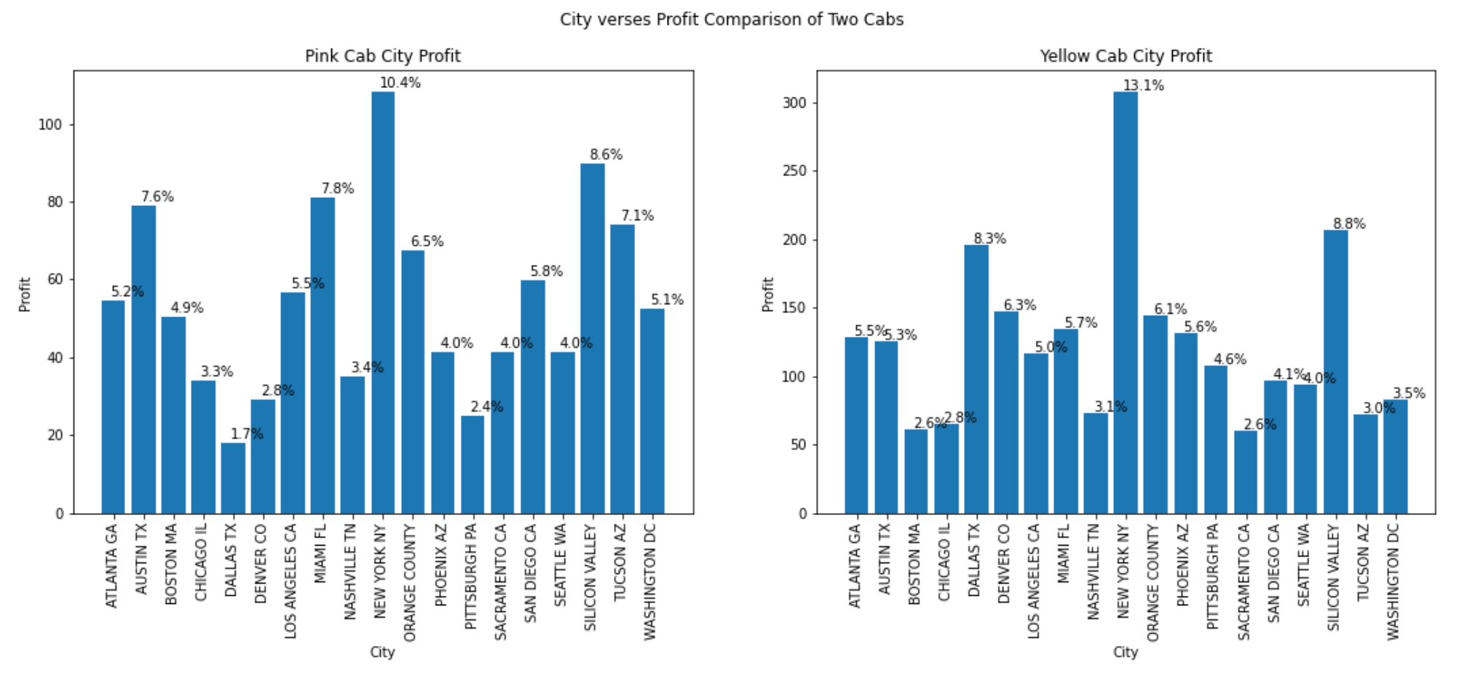
Data Visualization - cont
Analysis of Pink and Yellow cabs by City making Profit
Profit gained by New York City is the highest than any other City by both the cabs. Yellow cab has 13.1% of Profit from New York City and Pink Cab has 10.4% of Profit from New York City.

Slide 20
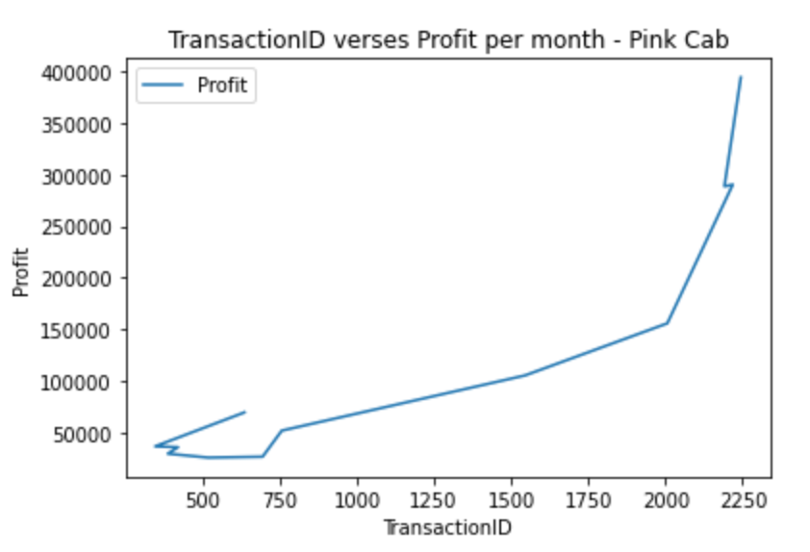
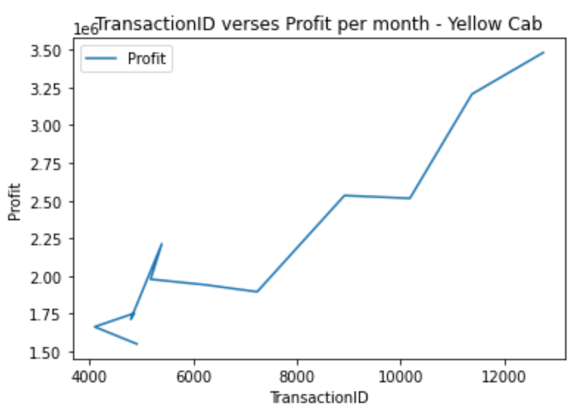
Data Visualization - cont
Analysis the monthly transaction vs Price of New York City for Pink and Yellow cab
For the above 2 graphs, it is depicted that Profit increased with an increase in number of transactions for both the cabs

Slide 21
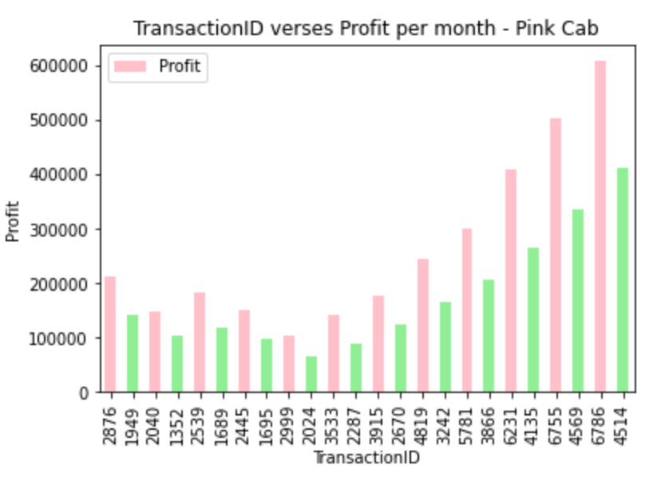
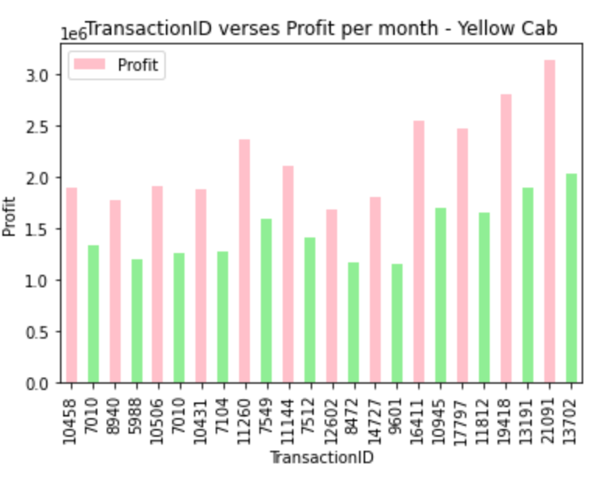
Data Visualization - cont
Analysis the monthly transaction vs Price for Pink and Yellow cabs
For the above 2 graphs, it is depicted that Card payment mode was higher for both the cabs compared to Cash on all months.

Slide 22
EDA Summary
PINK CAB | YELLOW CAB
Number of transactions are 23.6% | Number of transactions are 76.4%
Distance travelled is less than Yellow cab | Distance travelled is more than Pink cab
Profit increased with an increase in transaction | Profit increased with an increase in transaction
Card payment mode is most used | Card payment mode is most used
Profit margin is less than Yellow cab | Profit margin is more than Pink cab
Price charged for Male and Female customers are same | Price charged for Male customers is nearly 15% more than Female customers
Profit from Male and Female customers are nearly same | Profit from Male customers are huge than Female customers
Profit from highest transaction city New York is 10.4% | Profit from highest transaction city New York is 13.1%

Slide 23
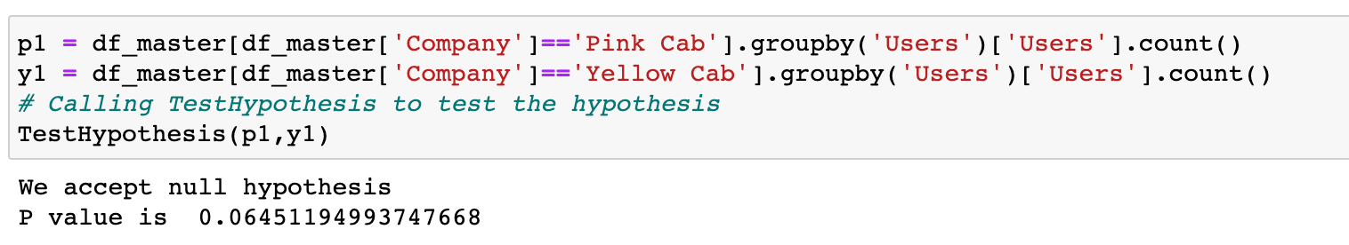
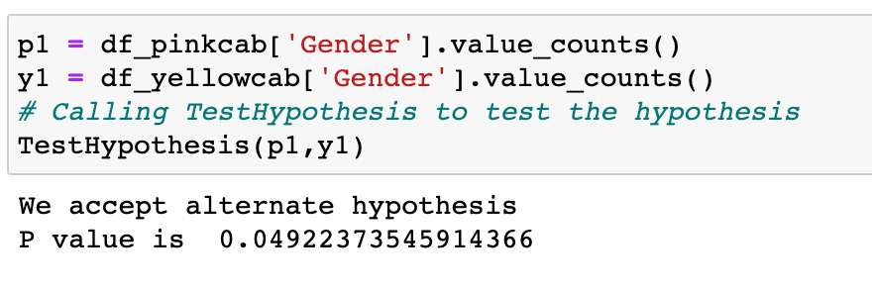
Hypothesis
Are the number of users different for both cabs
Null Hypothesis: The number of users are same for both cabs.
Alternate Hypothesis: The number of users are different for both cabs.
From the above hypothesis test, its proved that the number of users for both cabs are same.
Are the number of male and female customers different for both cabs
Null Hypothesis: The number of male and female customers are not different for both cabs.
Alternate Hypothesis: The number of male and female customers are different for both cabs.
From the above hypothesis test, its proved that the number of male and female customers for both cabs are different.
Hypothesis 1
Hypothesis 2

Slide 24
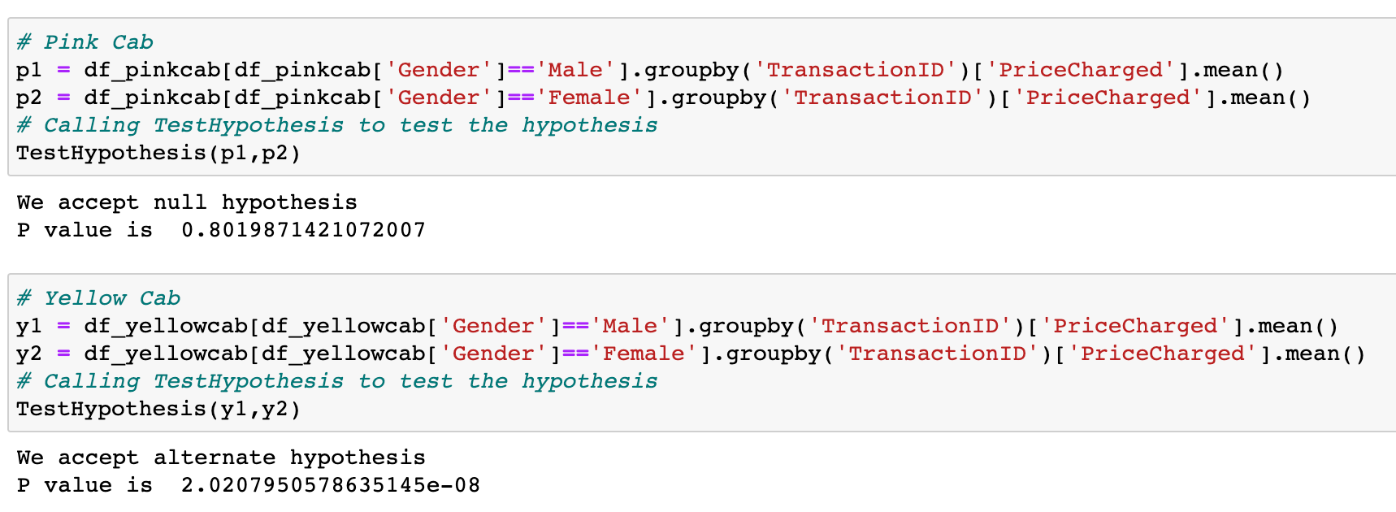
Hypothesis
Is there any difference in Price Charged between the Male and Female customers for both cabs
Null Hypothesis: There is no difference in Price Charged for Male and Female customers.
Alternate Hypothesis: There is a difference in Price Charged for Male and Female customers.
From the above hypothesis test, its proved that Pink cab charges nearly same Price for male and female customers. Whereas, Yellow cabs charges different price for male and female customers.
Hypothesis 3

Slide 25
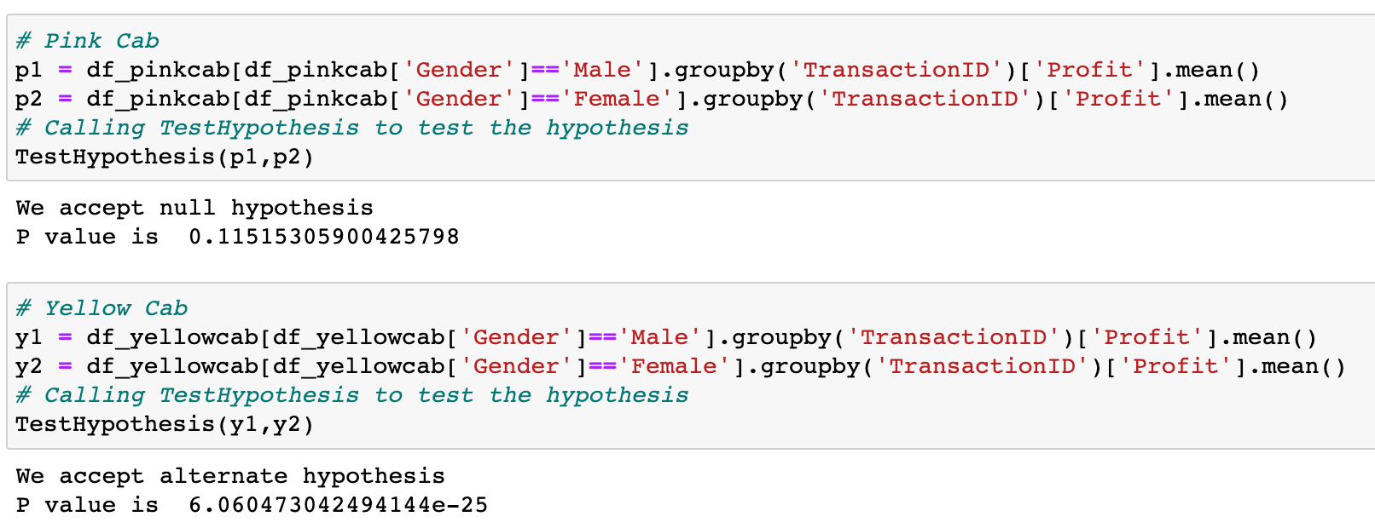
Hypothesis
Is there any difference in Profit margin between the Male and Female customers for both cabs
Null Hypothesis: There is no difference in Profit for Male and Female customers.
Alternate Hypothesis:There is a difference in Profit for Male and Female customers.
From the above hypothesis test, its proved that Pink cab has negligible Profit for male and female customers. Whereas, Yellow cabs different profit for male and female customers.
Hypothesis 4

Slide 26
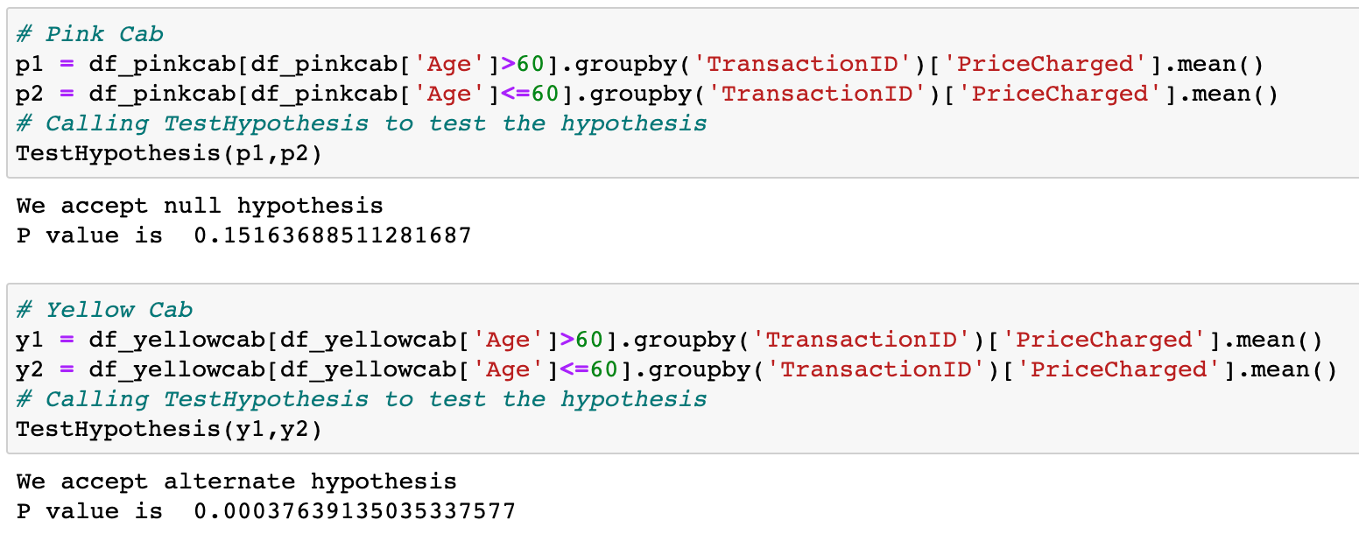
Hypothesis
Is there any difference on Price charged for Age > 60 for both cabs
Null Hypothesis: There is no difference on the Price Charged for the users above 60 years of Age.
Alternate Hypothesis: There is a difference on the Price Charged for the users above 60 years of Age.
From the above hypothesis test, its proved that Pink cab charges nearly same Price for customers above 60 years of age. Whereas, Yellow cabs charges less for the customers above the age of 60.
Hypothesis 5

Slide 27
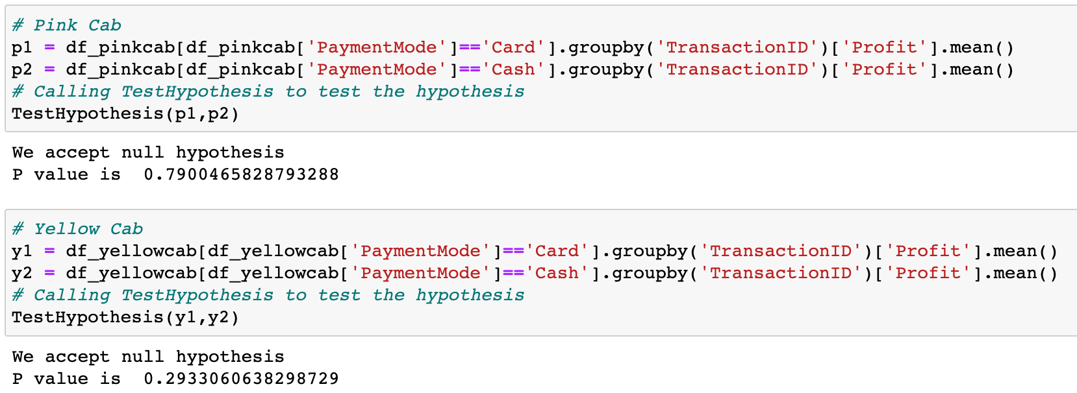
Hypothesis
Is there any difference on Price charged for Age > 60 for both cabs
Null Hypothesis: There is no difference in the Profit gained by Card and Cash Payment Mode.
Alternate Hypothesis: There is a difference in the Profit gained by Card and Cash Payment Mode.
From the above hypothesis test, its proved that there is no difference in the Profit gained by Payment Modes for both Pink cab and Yellow cabs.
Hypothesis 6

Slide 28
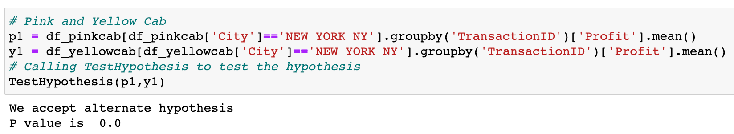
Hypothesis
Is there any difference in Profit gained from New York City for both cabs
Null Hypothesis: There is no difference in the Profit gained for New York City.
Alternate Hypothesis: There is a difference in the Profit gained for New York City.
From the above hypothesis test, its proved that there is difference in the Profit gained from New York City for both Pink cab and Yellow cabs.
Hypothesis 7

Slide 29
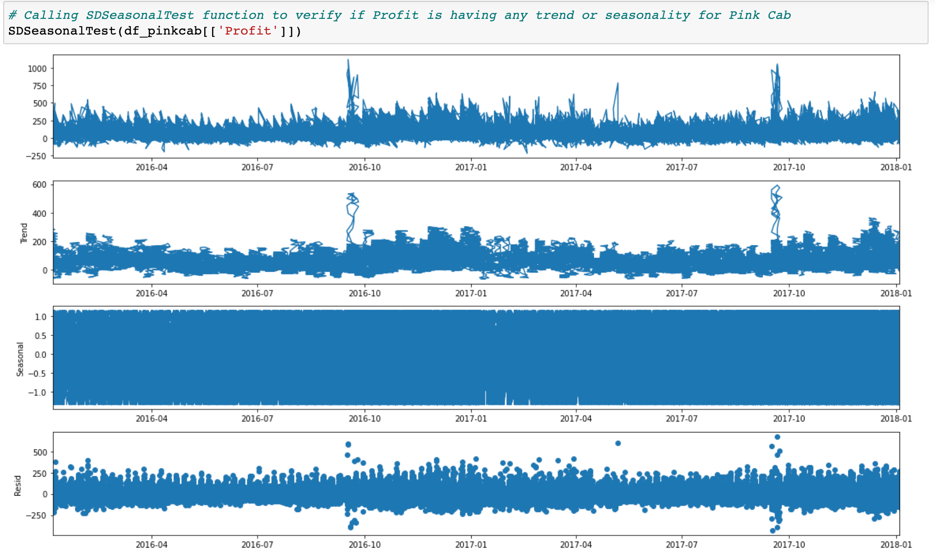
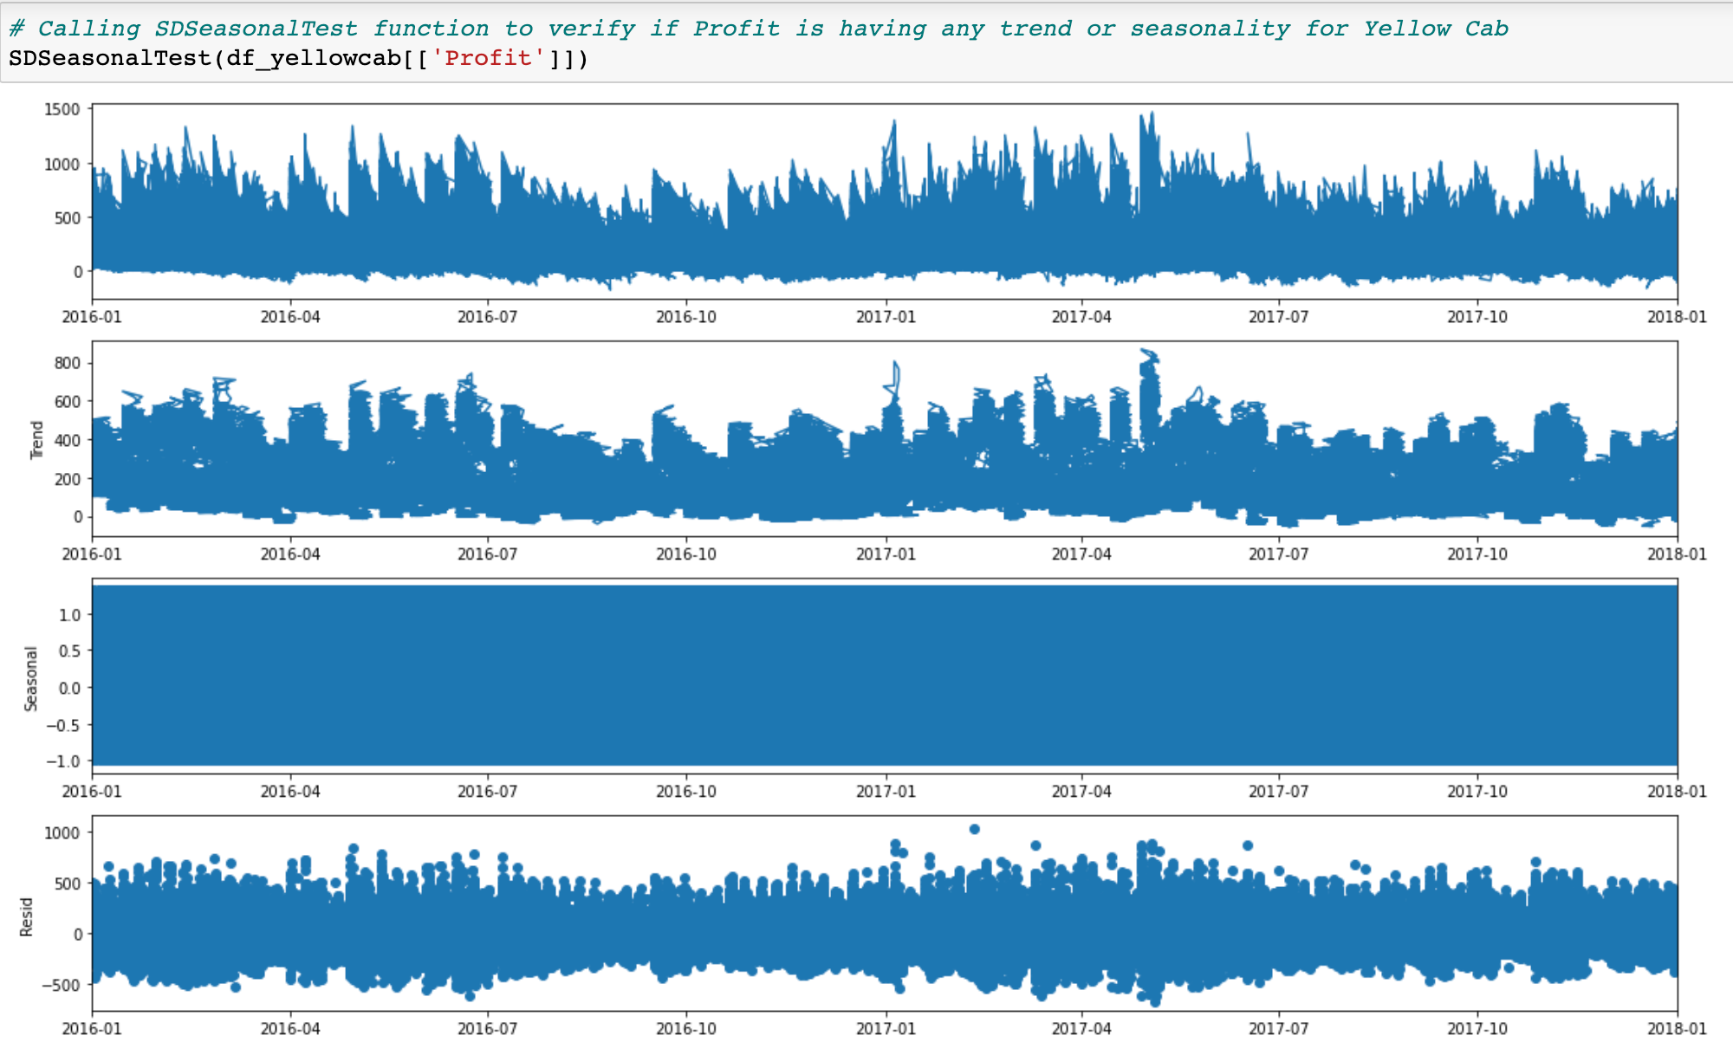
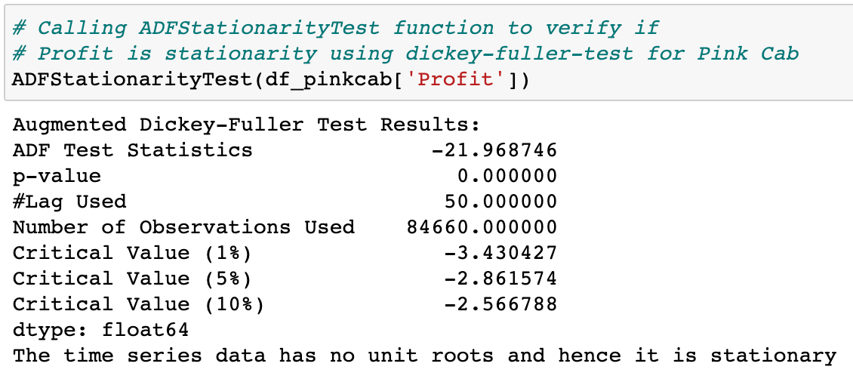
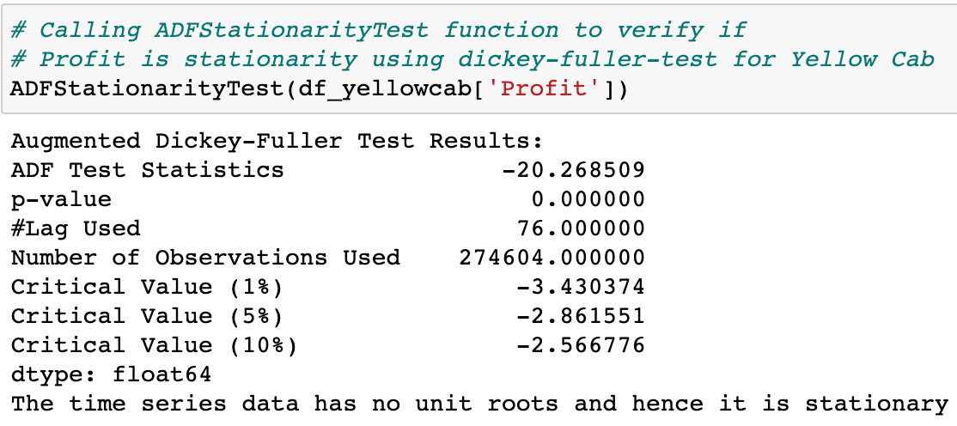
Hypothesis
Is there any seasonality for Profit for both cabs
Null Hypothesis: There is no trend and seasonality in the Profit gained for both cabs.
Alternate Hypothesis: There is a trend and seasonality in the Profit gained for both cabs.
From the above graphs and the p_value (0.000000), its proved that Profit variable is stationary and does not have any trend or seasonality for both Pink and Yellow cabs.
Hypothesis 8

Slide 30
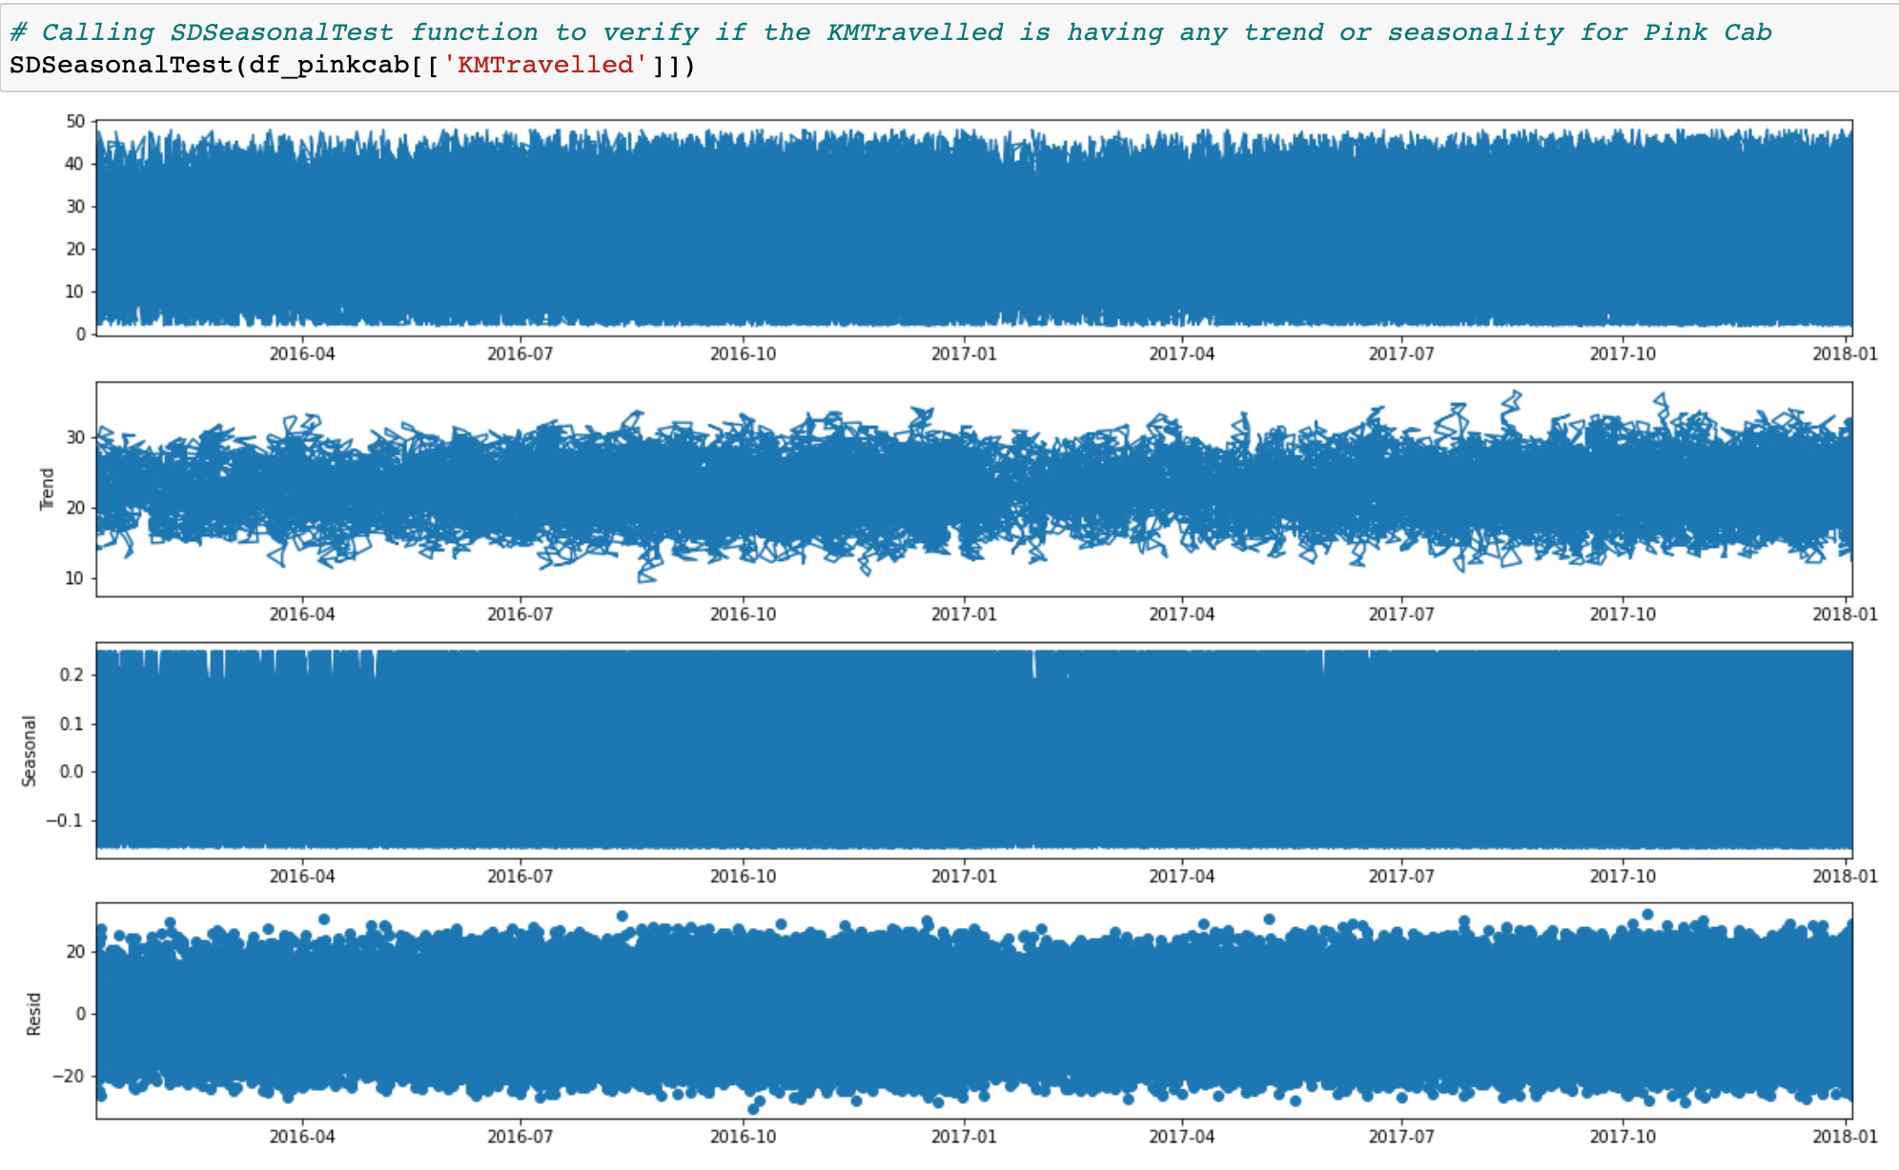
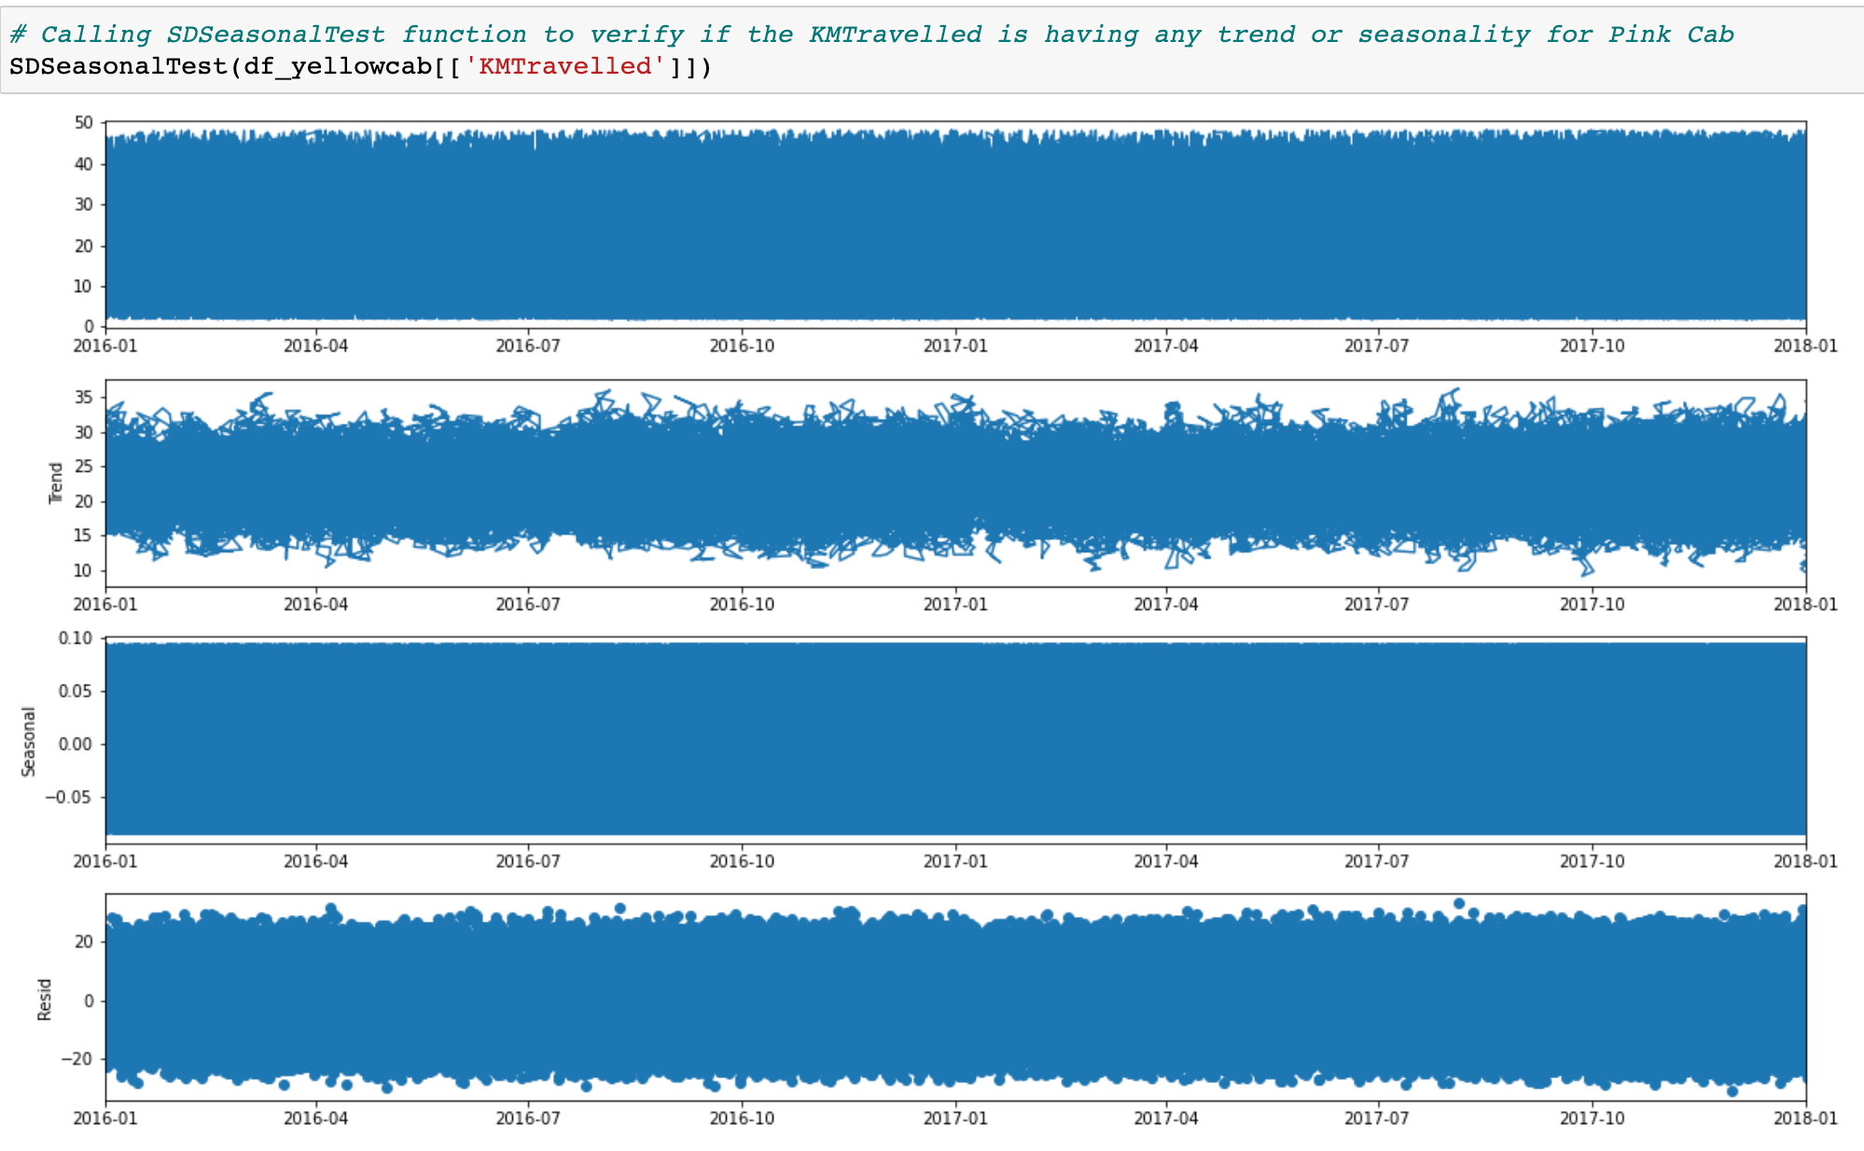
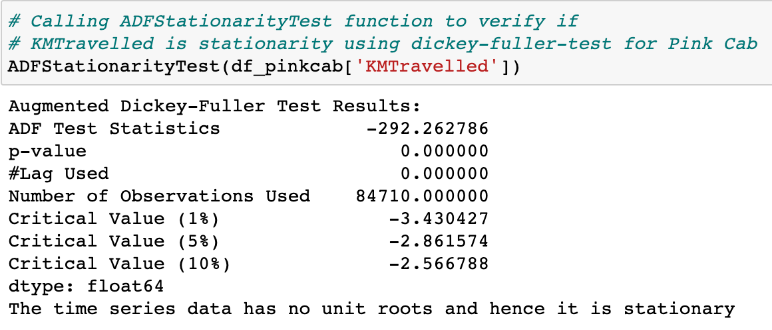
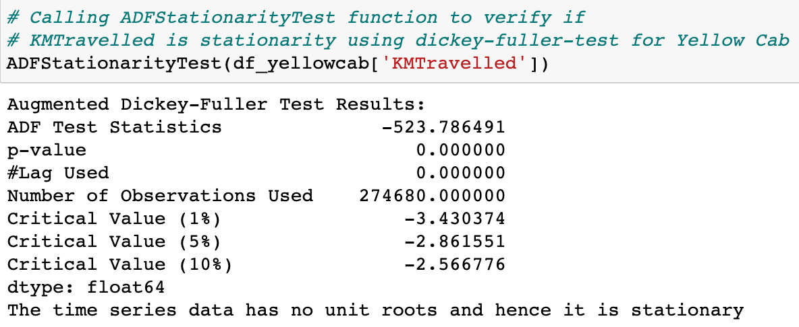
Hypothesis
Is there any seasonality in KM Travelled for both cabs
Null Hypothesis: There is no trend and seasonality in the KMTravelled for both cabs.
Alternate Hypothesis: There is a trend and seasonality in the KMTravelled for both cabs
From the above graphs and the p_value (0.000000), its proved that KMTravelled variable is stationary and does not have any trend and seasonality for both Pink and Yellow cabs.
Hypothesis 9

Slide 31
Recommendations
Looking at the results of Pinks cab and Yellow cab, the number of transactions and the profit margin for Yellow cab is much more than Pink cab. Hence the recommendation would be to invest in Yellow cab.

Slide 32
References
[1]https://www.kaggle.com/datasets/donnetew/us-holiday-dates-2004-2021

Slide 33
Thank You

